Slide 1
NFL Running Backs’ Second Season Performance

Slide 2
About this template
Project Outline
What question do I want to answer?
Scenario:
I am an NFL General Manager looking ahead to next season.
I want to have a better idea of what I can expect from certain players at different positions.
Specifically, what factor’s influence an NFL running back’s performance in their second season?
Independent Variables
Player’s final college season statistics
Player’s combine drill times and physical features
Player’s first NFL season statistics
Dependent Variable
Player’s second NFL season statistics

Slide 3
Project Roadmap
Data Selection
Data Merge
Data Analysis
1
3
5
2
4
6
Data Import
Exploratory Data Analysis & Cleaning Data
Final Thoughts

Slide 4
Data Selection & Import

Slide 5
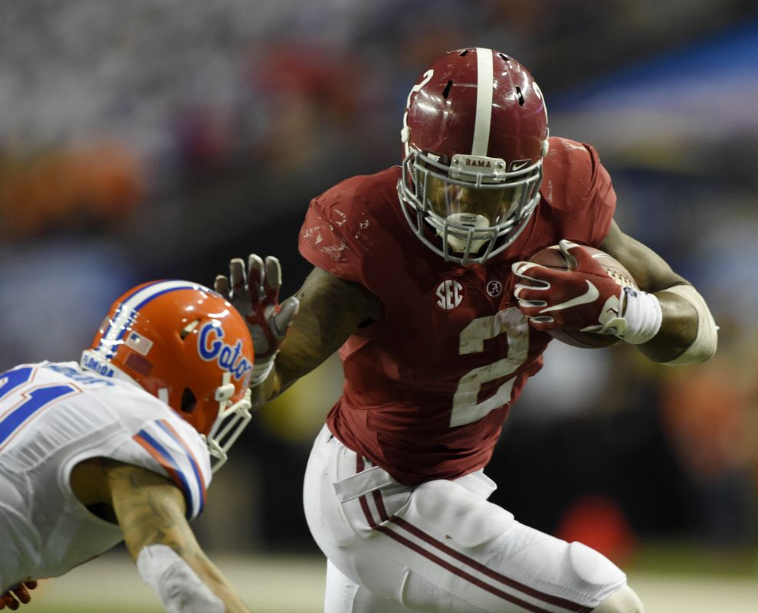
College Statistics
College Statistics from 2010 – 2019
Downloaded excel spreadsheets from sports-reference.com
Uploaded to Jupityr using pandas
Dropped ‘Rk’ and deleted symbols next to Player’s name indicating awards

Slide 6
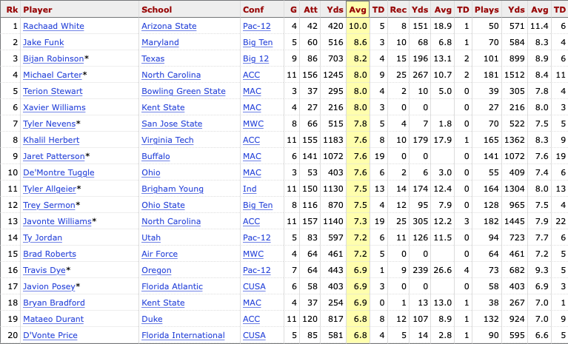
College Variables

Slide 7
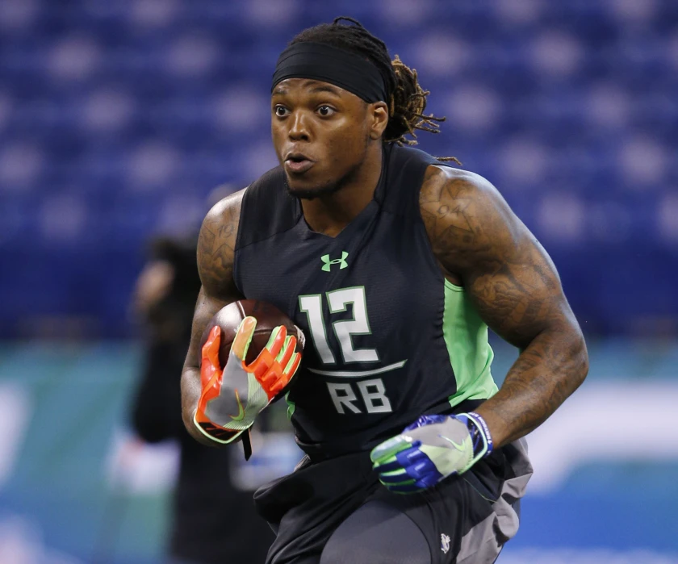
Combine Statistics
Combine Statistics from 2011 – 2020
Webscraped from nflcombineresults.com
Uploaded to Jupityr using BeautifulSoup
Changed ‘Name’ column to ‘Player’ to simplify merge

Slide 8
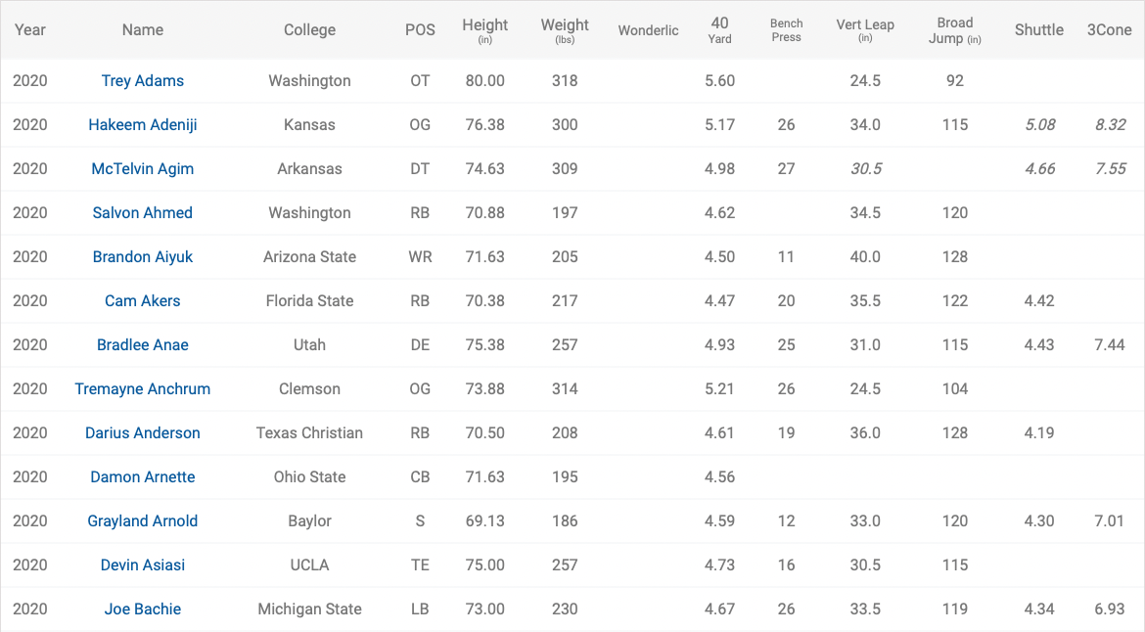
Combine Variables

Slide 9
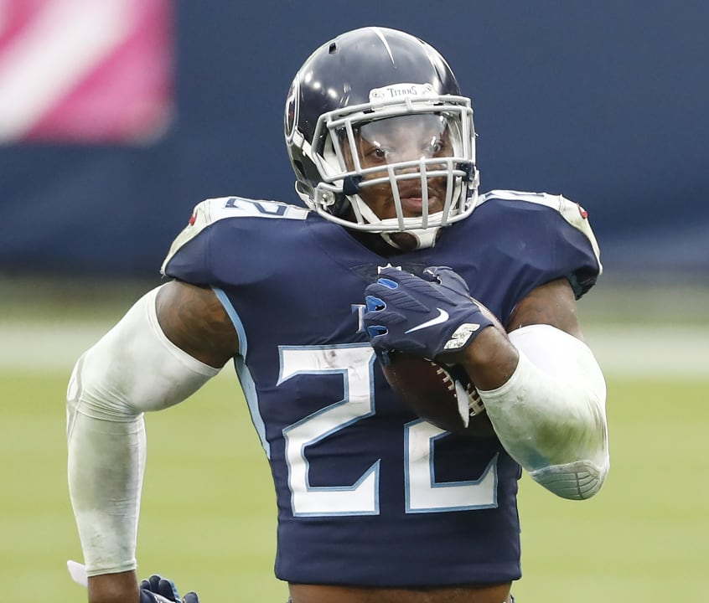
NFL Statistics
NFL Rush Statistics from 2011 – 2020
Downloaded excel spreadsheets from sports-reference.com
Uploaded to Jupityr using pandas
Dropped ‘Rk’ and deleted symbols next to Player’s name indicating awards

Slide 10
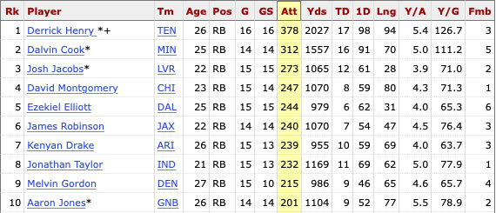
NFL Variables

Slide 11
Data Merge

Slide 12
Timeline
NFL Season Starts
Combine
NFL Season Starts
JUL
AUG
SEP
OCT
NOV
DEC
JAN
FEB
MAR
APR
MAY
JUN
College Season Starts
Draft

Slide 13
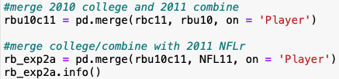
Merge Independent Variables
Left-join by ‘Player’
Output
2010/11 df
2011/12 df
……..
2019/20 df
Player | College 2010 | Combine 2011 | NFL 2011

Slide 14
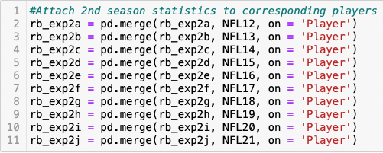
Merge Independent & Dependent Variables
Left-join by ‘Player’
Output
2010/11/12 df
2011/12/13 df
……..
2019/20/21 df
Player | College 2010 | Combine 2011 | NFL 2011 | NFL 2012

Slide 15
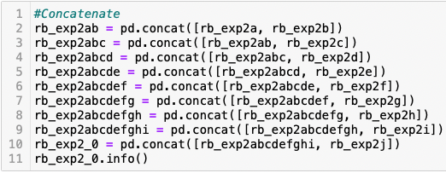
Concatenate Data Frames
Concatenate
Independent Variables
Player
College
Combine
NFL_x
Dependent
NFL_y
Player | College | Combine | NFL_x | NFL_y

Slide 16
Exploratory Data Analysis & Cleaning

Slide 17
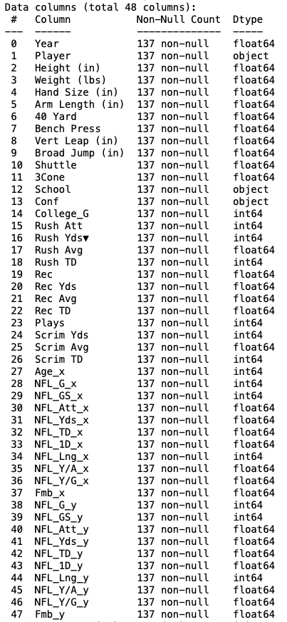
Column Types

Slide 18
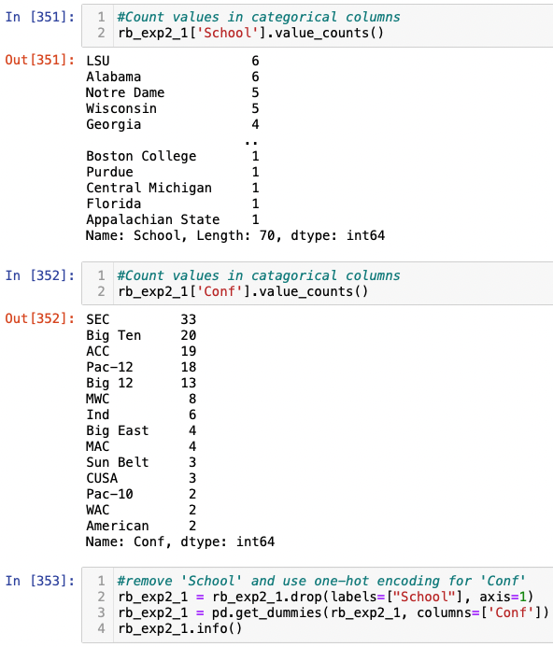
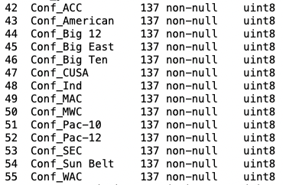
Manage Categorical Data

Slide 19
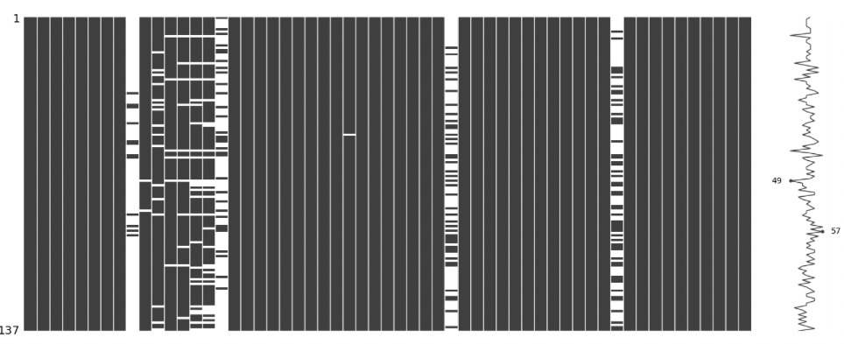
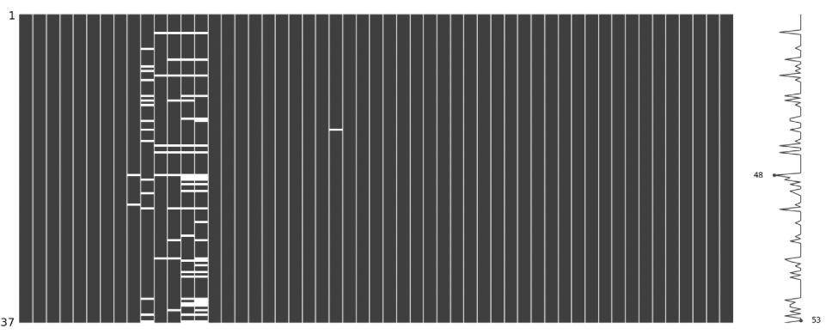
Missing Value Management
Step 1: Remove columns with a high percentage of missing values
Step 2: Interpolate remaining data to remove remaining N/A

Slide 20
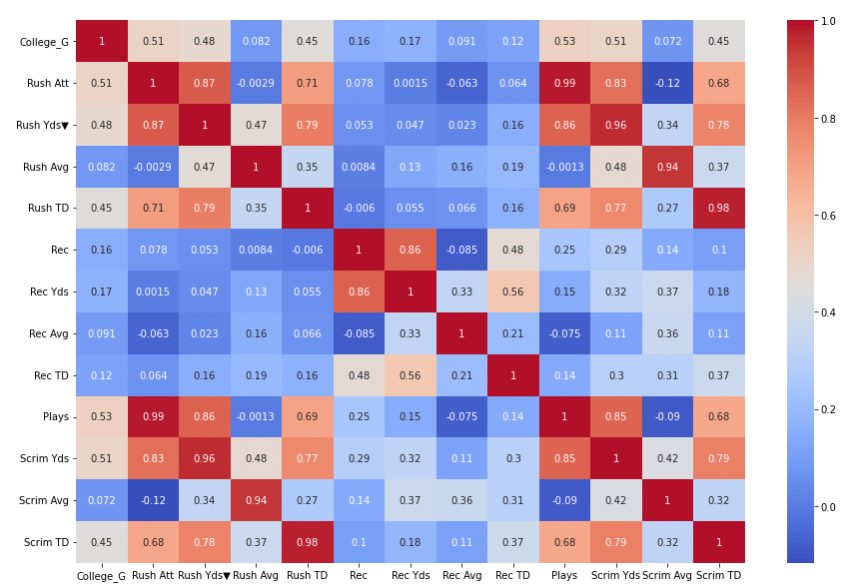
Multicollinearity: College

Slide 21
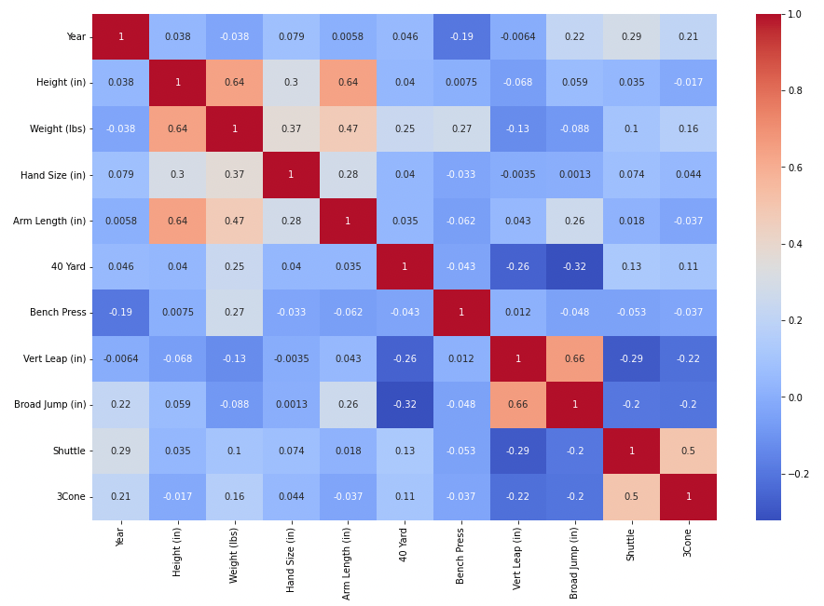
Multicollinearity: Combine

Slide 22
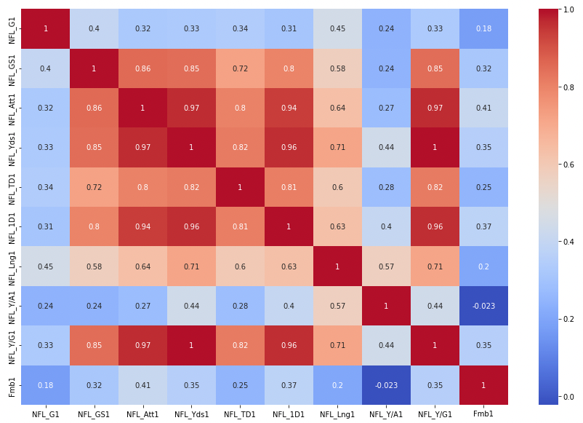
Multicollinearity: NFL

Slide 23
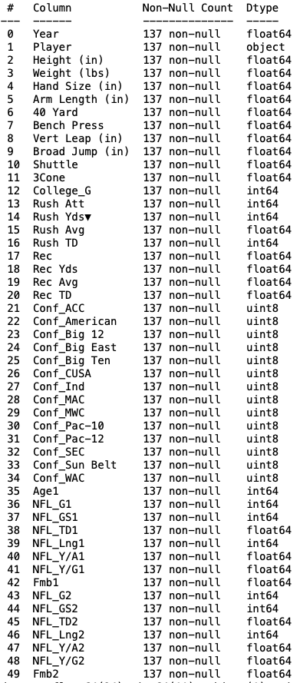
Pre-Analysis

Slide 24
Data Analysis

Slide 25
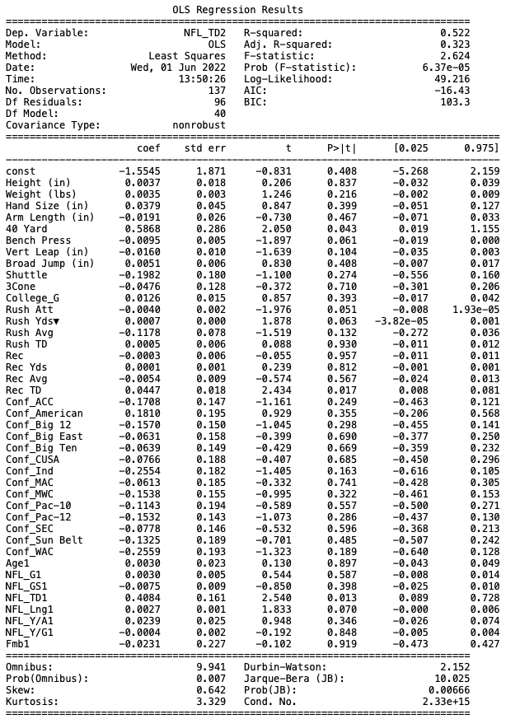
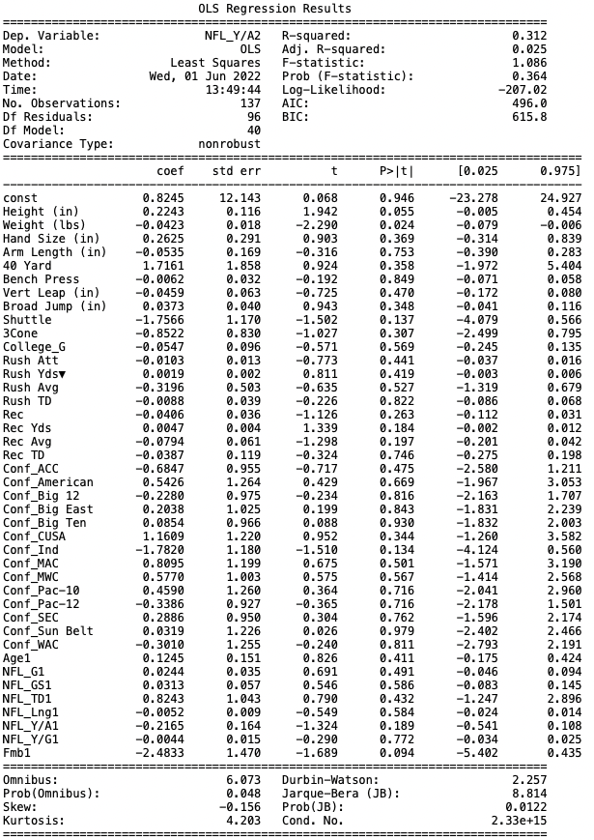
Ordinary Least Square Regression

Slide 26
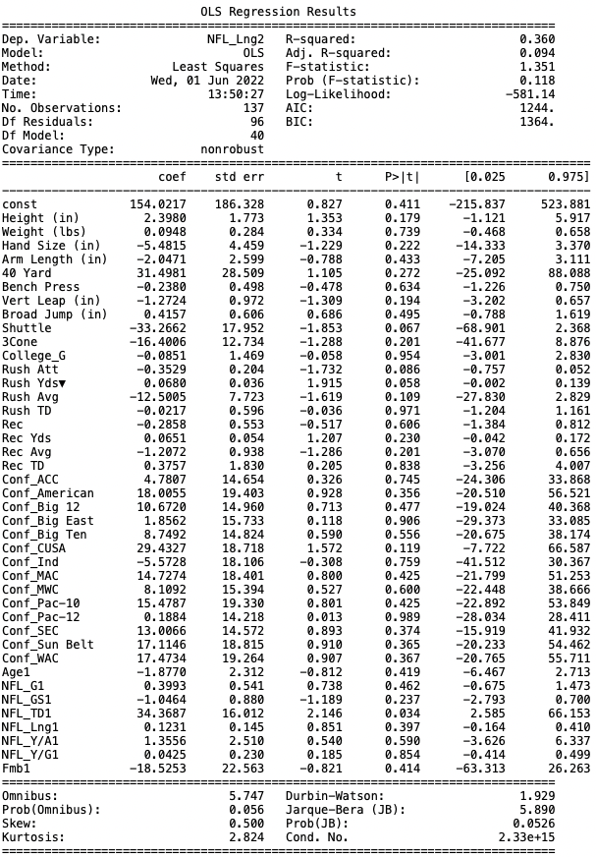
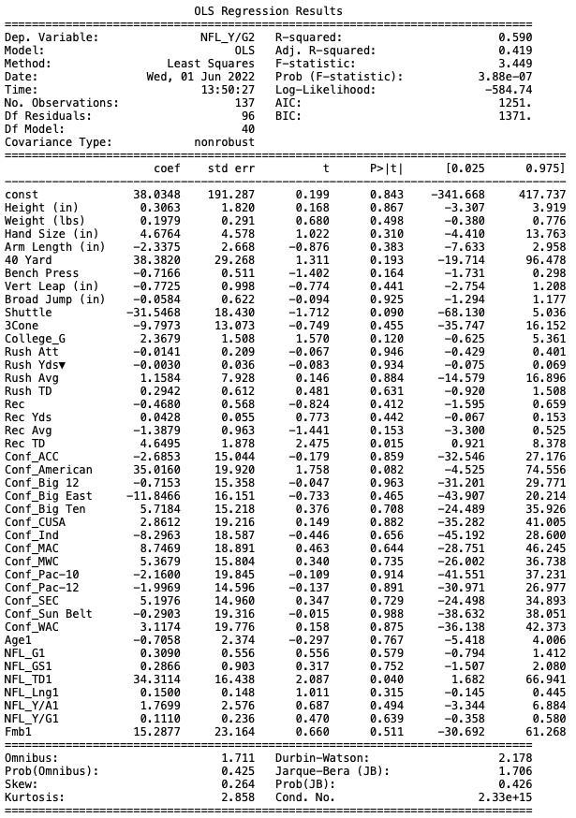
Ordinary Least Square Regression

Slide 27
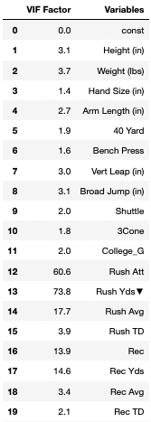
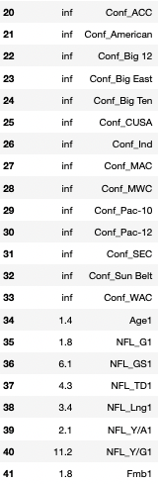
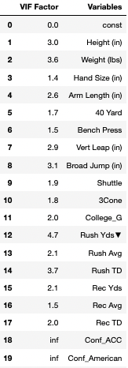
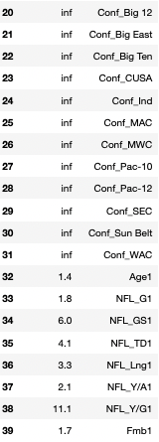
Variance Inflation Factor

Slide 28
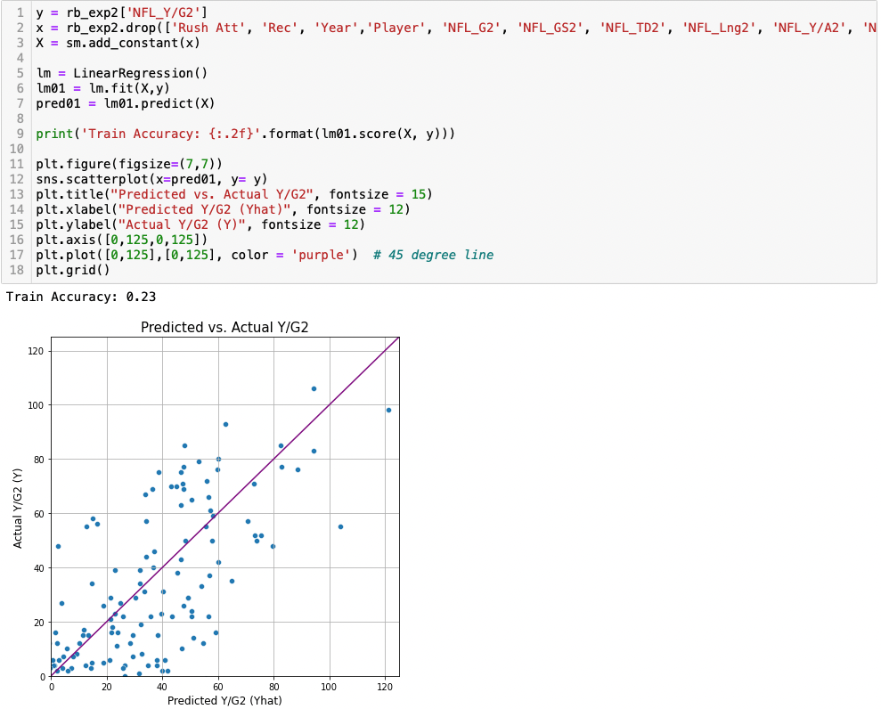
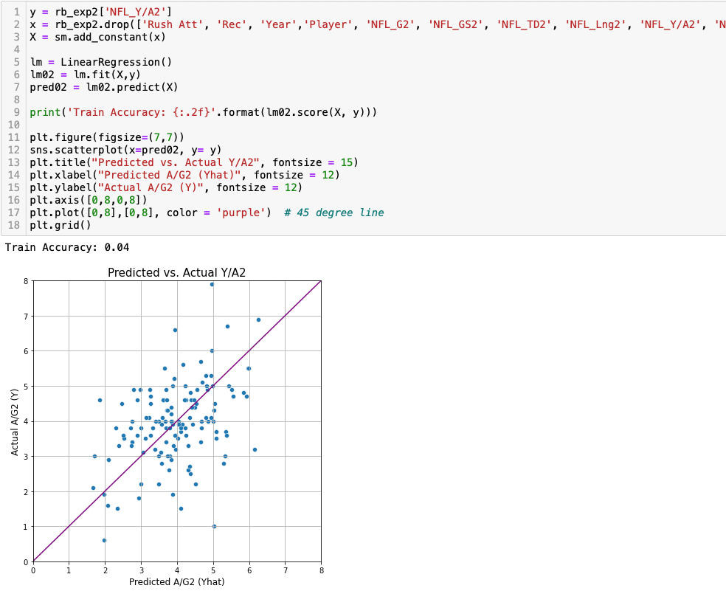
Prediction

Slide 29
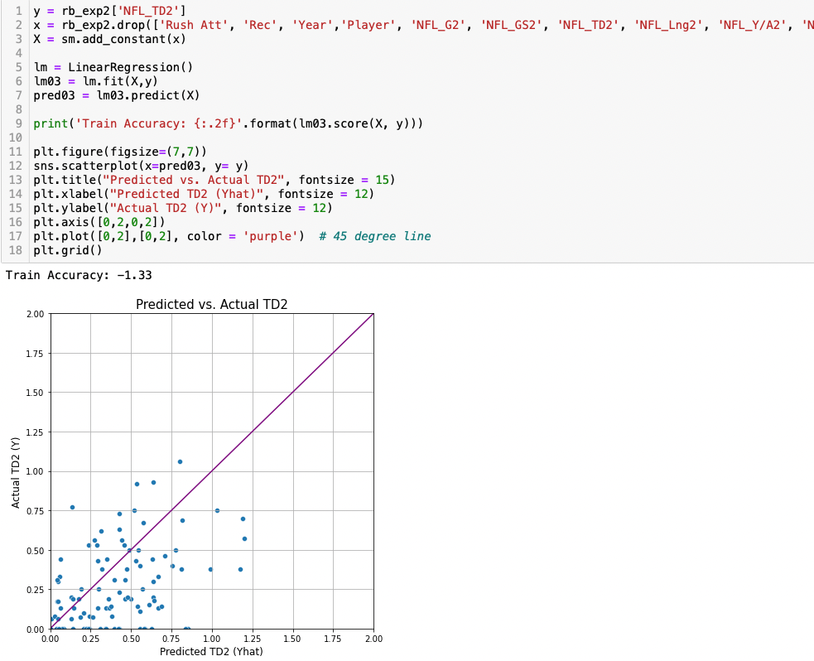
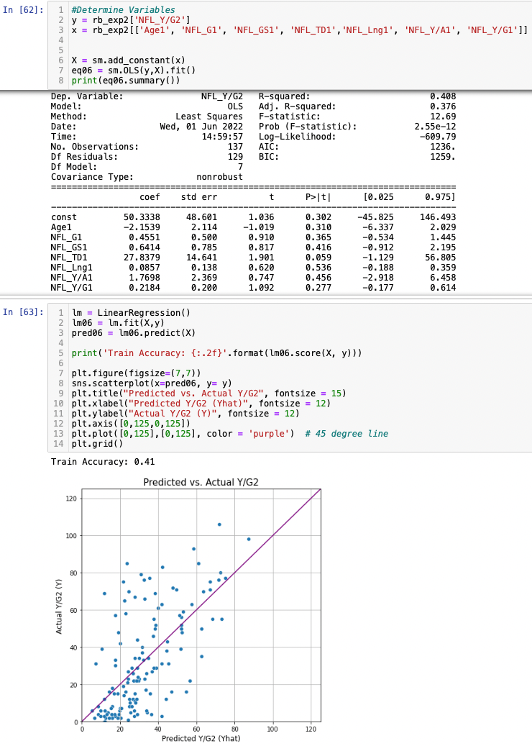
Prediction

Slide 30
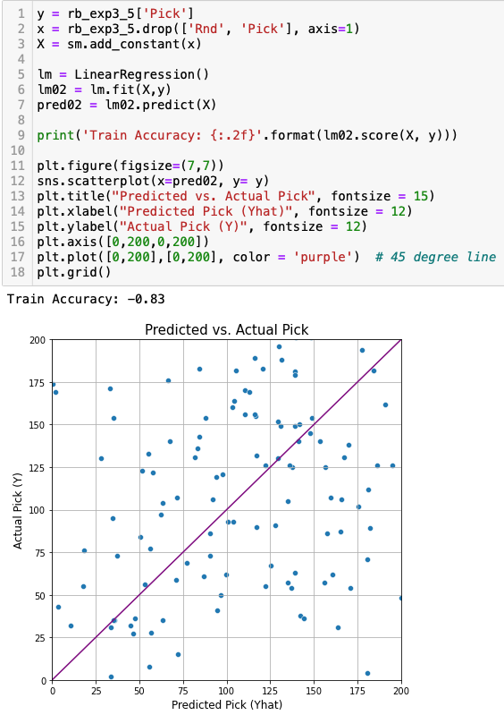
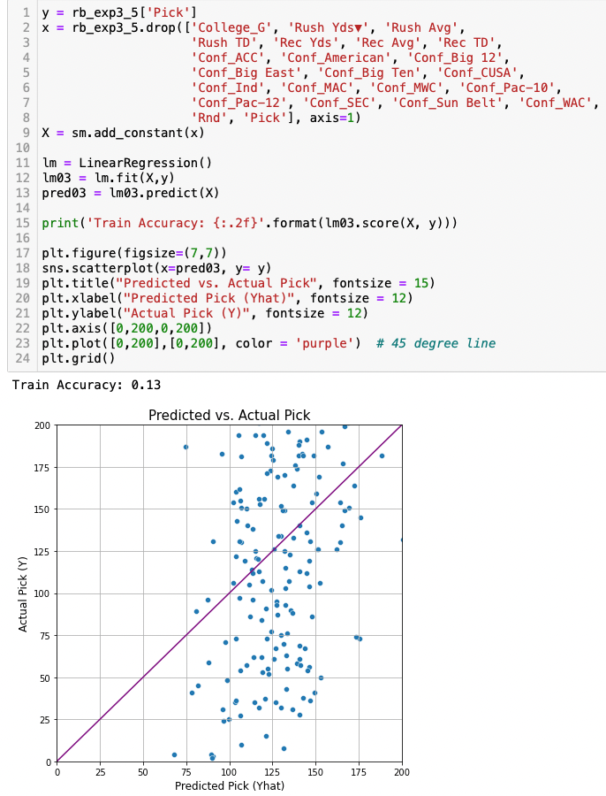
Exp 3

Slide 31
Final Thoughts

Slide 32
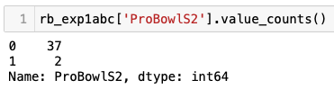
Sometimes, The Data Isn’t There
Originally, I wanted to predict whether or not a running back would make a ProBowl in their second season
However, if there isn’t enough data, it’s impossible to make an accurate assessment or prediction

Slide 33
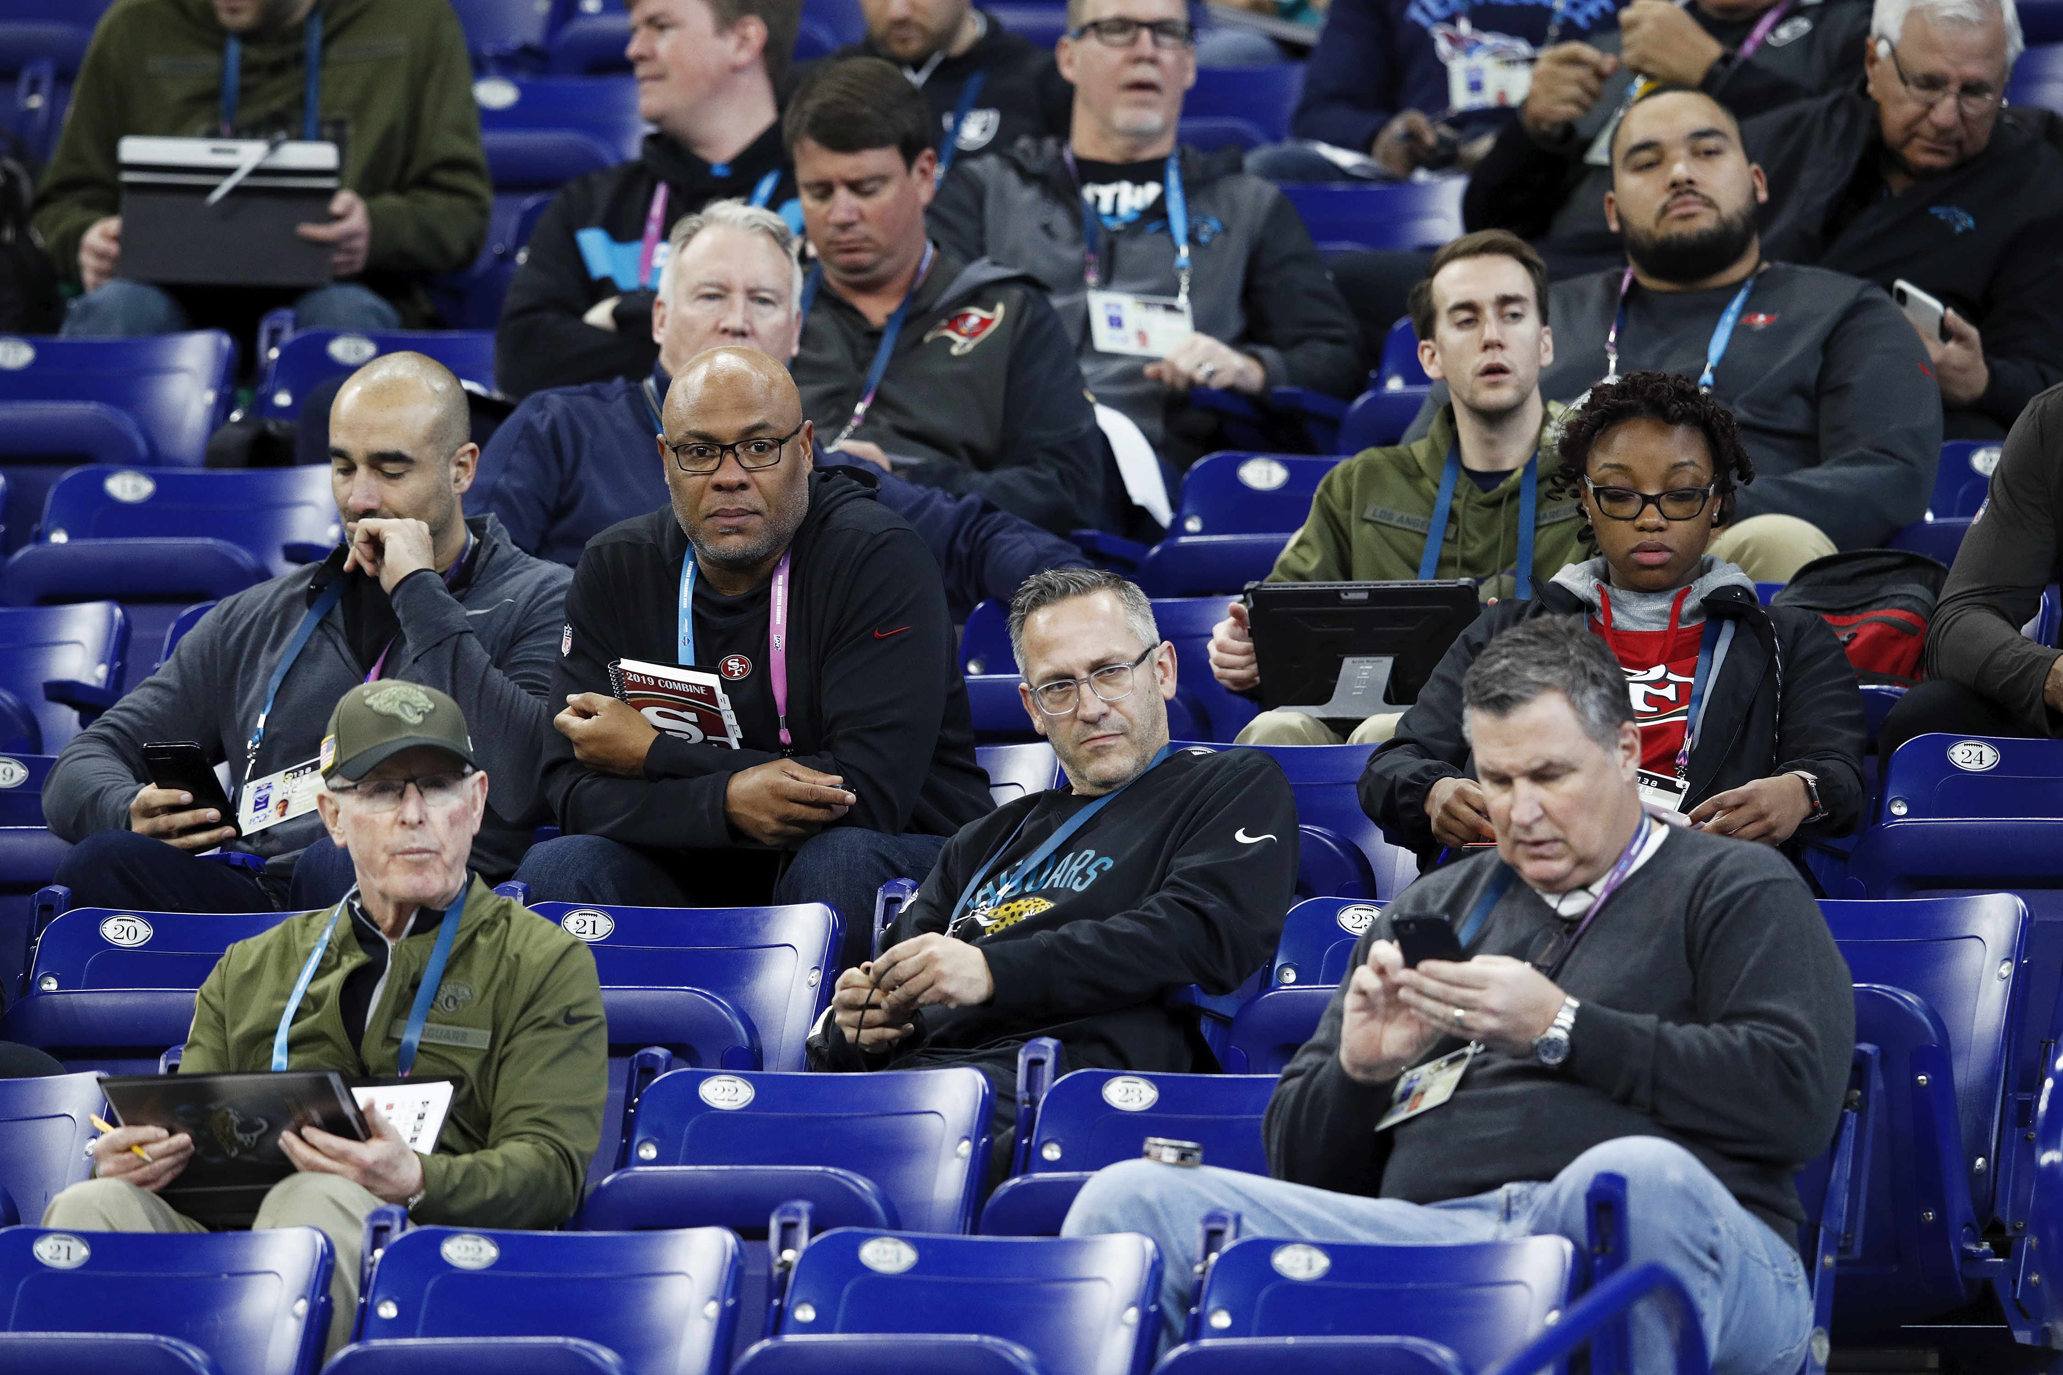
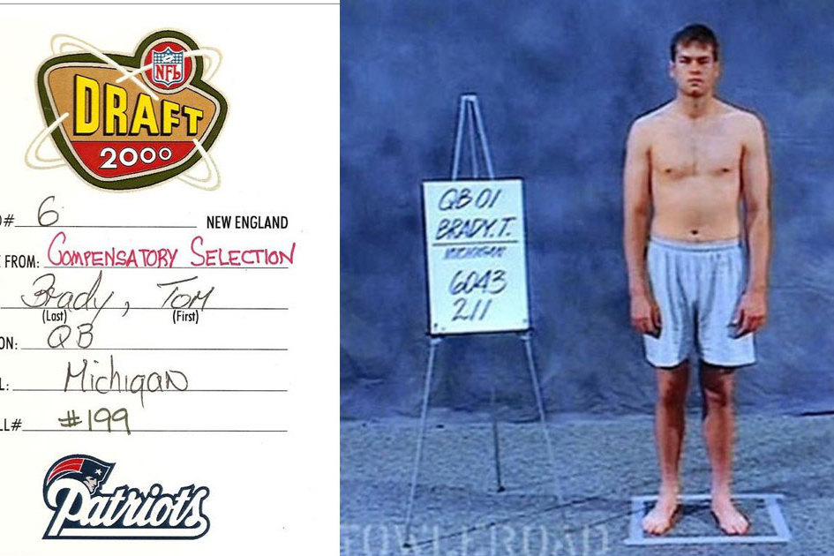
Scouts Exist For A Reason
It’s very hard to predict how successful a player will be in the NFL

Slide 34
Context Is Key
Easily able to eliminate variables I knew to be redundant
Example: Total Yards and Yards per Game
Tell a story with the findings
Correlation between Weight and Yards per Carry
Expand/improve the model
Different positions
Create my own variable

Slide 35
Thanks!
ANY QUESTIONS?
You can find me at:
linkedin.com/in/richard-kuehn
rickykuehn@gmail.com

